Slide 1


Travel Management System
2024
Python Programming Language In GUI

Slide 2

Introduction
2024
A Travel Management System (TMS) is a software application designed to facilitate the planning, booking and management of travel arrangements for individuals or organizations. It streamlines the entire travel process, making it easier for users to manage their travel needs efficiently. A Travel Management System is an essential tool for both individual travelers and organizations looking to streamline their travel processes. By leveraging technology, it enhances the overall travel experience, making it more efficient, cost-effective and user-friendly. Whether for personal trips or corporate travel management, a TMS can significantly improve how Travel Managements are handled.
Overview Of Travel Management System

Slide 3

Introduction
2024
Purpose And Functionalities

Slide 4

Purpose and Functionalities
2024
Purpose
Functionalities
The primary purpose of Travel Management System (TMS) is to simplify and streamline the process of planning, booking and managing travel arrangements for individuals and organizations. It aims to enhance the overall travel experience by providing a centralized platform that integrates various travel-related services.
A Travel Management System typically includes a wide range of functionalities designed to meet the diverse needs of travelers. Rate conseris ma as dolupta idis aut apicide ruptatio.
User Registration and Authentication
Customer Information Management
Travel Package Selection
Destination and Accommodation Options
Cost Calculation
Receipt Generation

Slide 5


PICTURE SLIDE
2024

Slide 6


Technologies Used
20XX
Python Programming Language

Slide 7
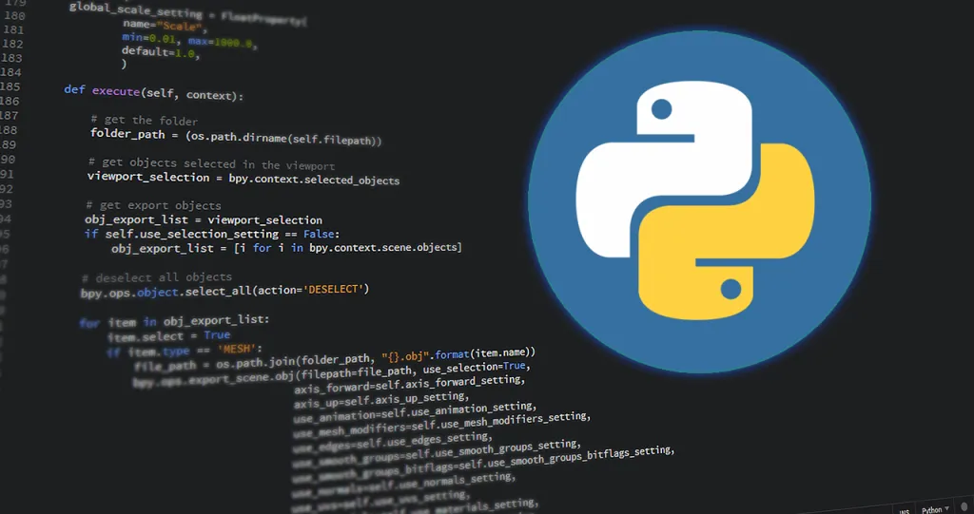
2024
Python is a high-level, interpreted programming language known for its simplicity and readability. It was created by Guido van Rossum and first released in 1991. Python has gained immense popularity due to its versatility, ease of learning, and a vast ecosystem of libraries and frameworks that support various applications, from web development to data analysis and artificial intelligence.

Slide 8

Technologies Used
2024
Tkinter for GUI
Tkinter is the standard GUI (Graphical User Interface) toolkit for Python. It provides a powerful object-oriented interface to Tk GUI toolkit, which is widely used for creating desktop applications. Tkinter is included with most Python installations, making it readily available for developers. Tkinter is a powerful and easy-to-use toolkit for creating GUI applications in Python. Its simplicity and flexibility make it an excellent choice for both beginners and experienced developers. Whether you're developing simple tools or complex applications, Tkinter provides the necessary components to create effective user interfaces.

Slide 9

Technologies Used
2024
ReportLab for PDF Generation
ReportLab is a powerful library for generating PDF documents programmatically in Python. It is widely used for creating complex documents, reports, and graphics, making it a popular choice for applications that require dynamic PDF generation. Its ability to create complex layouts, support for graphics, and extensive text formatting options make it suitable for a wide range of applications, from simple reports to sophisticated documents. Whether you are creating a one-off report or a dynamic document generation system, ReportLab provides the tools you need to create professional-quality PDFs.

Slide 10

System Features
2024
Customer details input

Slide 11

2024
The code you provided is a comprehensive implementation of a Travel Management System using Tkinter in Python. It includes various features such as customer details input, travel package selection, cost calculation, and receipt generation. Below, I will highlight the sections of the code that specifically relate to customer details input and provide a brief explanation of how they work. The customer details input section of the Travel Management System is designed to be user-friendly and efficient. It allows users to enter their information easily, and the integration with other functionalities (like receipt generation and data resetting) enhances the overall usability of the application. You can further expand this section by adding more fields or improving validation as needed.

Slide 12
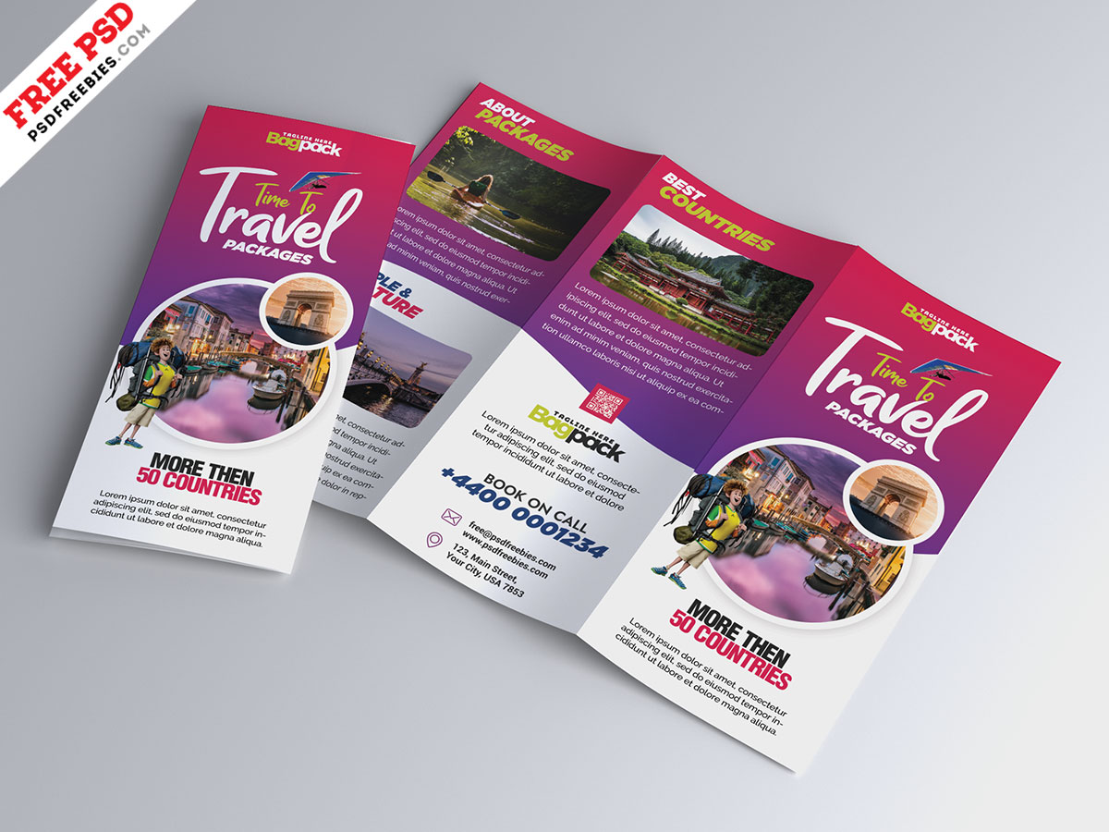
System Features
2024
Travel Package Selection
The provided code for the Travel Management System includes a feature for selecting travel packages and corresponding places.
User -Friendly Interface: The use of ComboBoxes for package and place selection makes it easy for users to navigate through options.
Dynamic Updates: The system dynamically updates available places based on the selected package, enhancing user experience.
Cost Transparency: The display of place prices allows users to see costs upfront, aiding in informed decision-making.
Comprehensive Cost Calculation: The integration of various factors (number of persons, selected services) into the total cost calculation ensures accurate pricing.
These features collectively create a robust travel package selection system that is both functional and user-friendly, making it easier for users to plan their trips effectively

Slide 13

System Features
2024
Cost Calculation
The total cost is calculated in real-time based on user selections, ensuring that users see accurate pricing as they make choices.
The system retrieves base prices for selected places from the predefined dictionary, ensuring that the pricing is consistent and easily manageable.
Users can select various additional services, and the system automatically includes their costs in the total calculation, providing flexibility in travel planning.
The ability to input the number of persons allows for accurate group pricing, making it suitable for families or groups traveling together.
The system calculates a 5% tax on the subtotal, ensuring that users are aware of the total cost they will incur, including taxes.
The implementation includes checks to ensure that the number of persons is valid, preventing errors in cost calculations and enhancing user experience.
The display of paid tax, subtotal, and total cost gives users a clear understanding of how their final price is derived, fostering trust in the system.

Slide 14
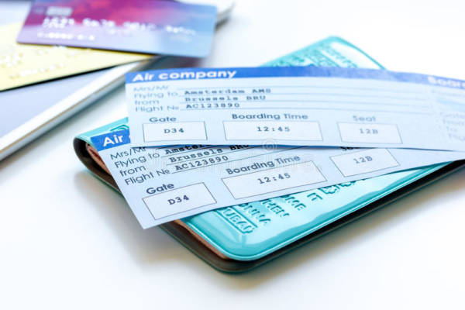
System Features
2024
Receipt Generation
The receipt generation feature in the Travel Management System is designed to compile all relevant information about a user's travel booking into a formatted receipt. This receipt can be displayed on the screen and printed as a PDF file. Below are the key features of the receipt generation system, along with explanations of how they are implemented in the code.
The receipt includes all relevant booking details, ensuring users have a complete record of their transaction.
Each receipt has a unique reference number, aiding in tracking and management of bookings.
The date of the order is automatically included, providing a clear record of when the booking was made.
Users can save their receipt as a PDF, allowing for easy printing and storage.

Slide 15

System Features
2024
PDF Printing Option
The PDF printing option in the Travel Management System allows users to save their travel booking receipt as a PDF file. This feature is essential for users who want a physical copy of their receipt or wish to store it digitally for future reference. Below, I will outline the key features of the PDF printing option, along with the relevant code implementation.
Users are prompted to enter a filename for the PDF, allowing for easy organization of receipts.
The `reportLab` library is used to create the PDF, ensuring high-quality output.
All relevant information is included in the PDF, making it a complete record of the transaction.
After saving the PDF, users receive a confirmation message, enhancing the user experience.

Slide 16

Code Structure
2024
Class based Architecture

Slide 17

2024
TravelApp: The main application class that initializes the GUI and manages the overall application flow.
CustomerDetails: A class to handle customer-related information and input fields.
TravelDetails: A class to manage travel-related information, including package selection and place options.
CostDetails: A class to handle cost calculations and display.
Receipt: A class to manage receipt generation and printing.

Slide 18

Code Structure
2024
GUI Components
In the refactored Travel Management System, various GUI components are utilized to create an interactive and user-friendly interface. Below is a breakdown of the key GUI components used in the application, categorized by their purpose and functionality. By using a combination of frames, labels, entry fields, comboboxes, buttons, checkbuttons, and text areas, the application effectively captures user input, displays information, and facilitates interaction. The use of message boxes enhances user experience by providing feedback and confirmations. Overall, these components work together to create a cohesive and functional travel management application.

Slide 19

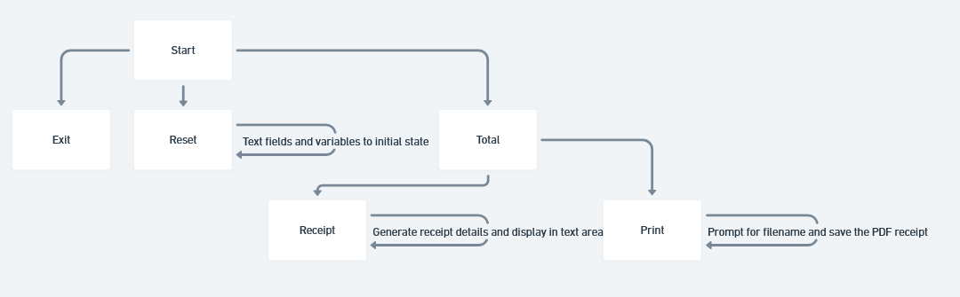
Flow Chart
20XX
Visual Representation of the system’s workflow

Slide 20
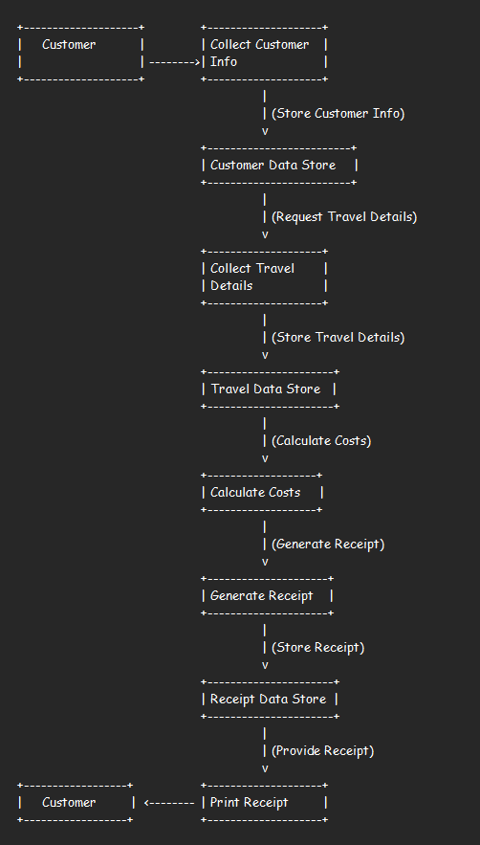
Data Flow Diagram
20XX
Representation of data movement within the system

Slide 21

Conclusion
2024
The Travel Management System is a comprehensive and user-friendly application designed to streamline the process of managing travel bookings. The system offers several key features, including customer details input, travel package selection, cost calculation, receipt generation, and PDF printing. These features work together to provide an efficient and organized experience for both customers and administrators. The system's class-based architecture, key functions, and GUI components are designed to promote modularity, readability, and maintainability.

Slide 22

THANK YOU!
2024
Mihir Bhayani – 92200577027
Karan Sundavadra – 92200577028
MananKumar Bhalodiya - 92200577038

